Slide 1
January 2022
Service Change
Tuesday, December 7, 2021 at Noon

Slide 2
JANUARY 2022 SERVICE CHANGE
Summary of Changes
The upcoming service changes will take effect starting Monday, January 3, 2022.
LINES | LINE NAME | CHANGES
1 | Kenny/Livingston | Restore short turn and frequency adjustment
2 | E Main/ N High | Restore short turn and frequency adjustment
3 | Harrisburg/Northwest | Frequency adjustment
10 | E Broad/W Broad | Restore short turn and frequency adjustment
22 | OSU/Rickenbacker | Frequency adjustment
23 | James/Stelzer | Frequency adjustment
LINES | LINE NAME | CHANGES
24 | Hamilton | Frequency adjustment & modifications to service in Rickenbacker
25 | Brice | Frequency adjustment & restoring service to Easton
34 | Morse | Frequency adjustment
102 | N High/Polaris Pkwy | Frequency adjustment
CMAX |  | Restore short turn and frequency adjustment

Slide 3
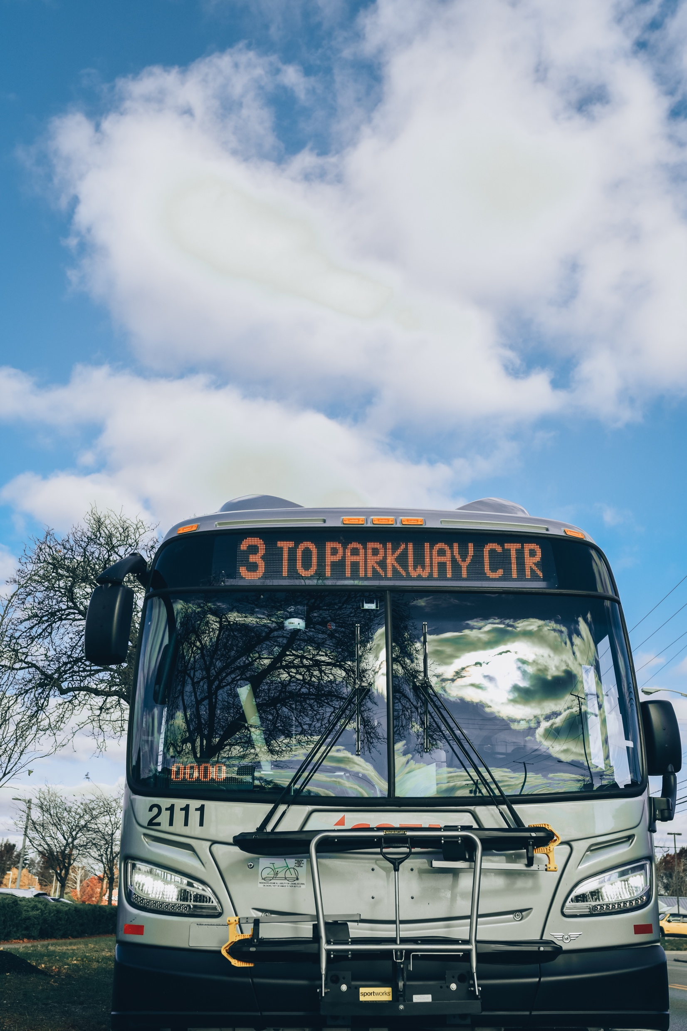
Short Turns
COTA will resume “short turning” on several lines
in January. Short turning a bus allows for extra
service on busier sections of the route
What is a short turn?
A short turn is where a transit vehicle ends its trip at a popular destination for riders (short of the end of the line) and heads back in the opposite direction.
How will this affect my commute?
Passengers may be asked to exit the bus and wait for the next arriving bus to continue to the end of the line.
Check the destination header sign on the front of the bus to see which route you are boarding. Destination headers flip between the line name, direction and destination.
If you are ever in doubt, ask the operator and they will confirm which bus you are boarding.

Slide 4
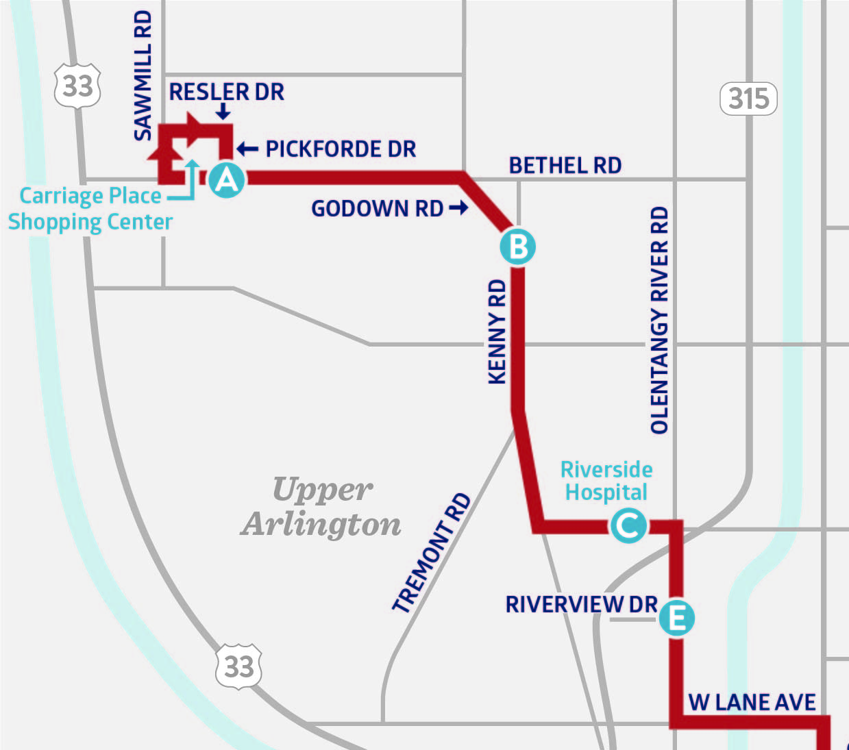
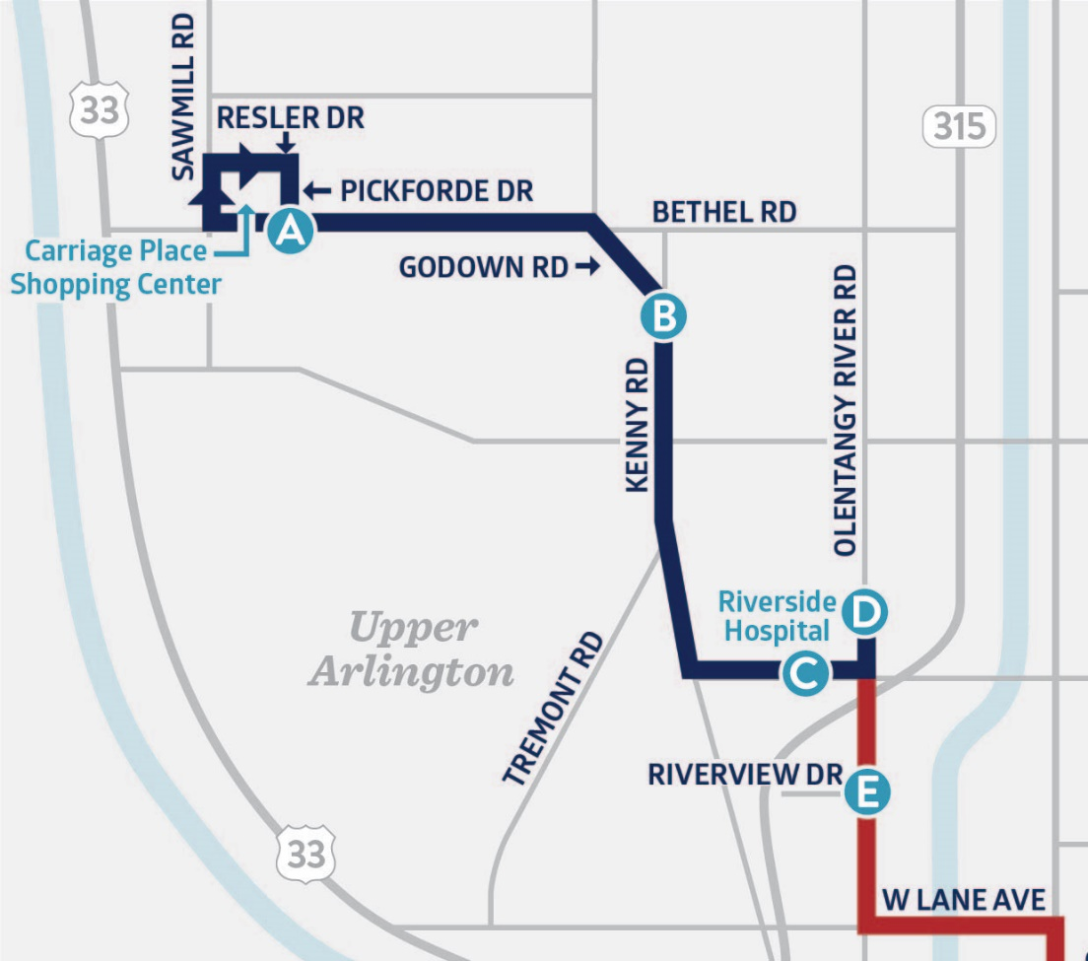
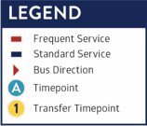
JANUARY 2022 SERVICE CHANGE
Line 1 will return to Riverside Hospital using Thomas Lane. Trips from Carriage Place Shopping Center to Riverside Hospital will run every 30 minutes. Check the destination header on the front of the bus to ensure you board the correct bus.
Line 1 Routing Change
Line 1: Current northern alignment
Line 1: Northern alignment in January

Slide 5
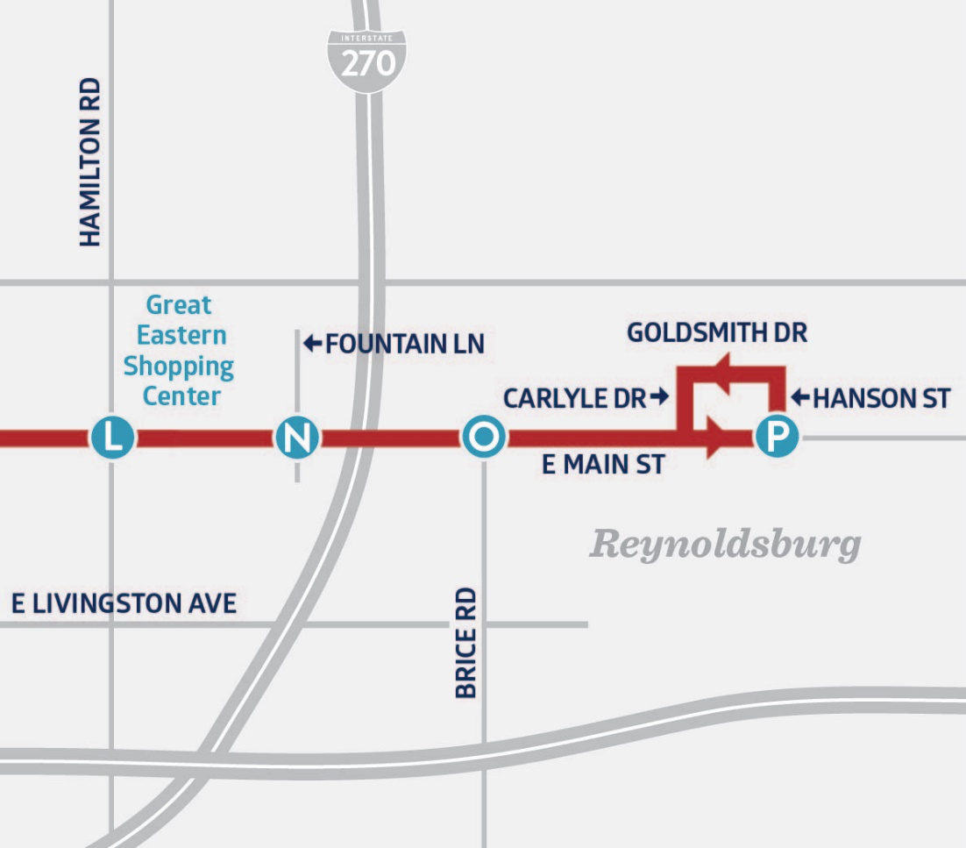
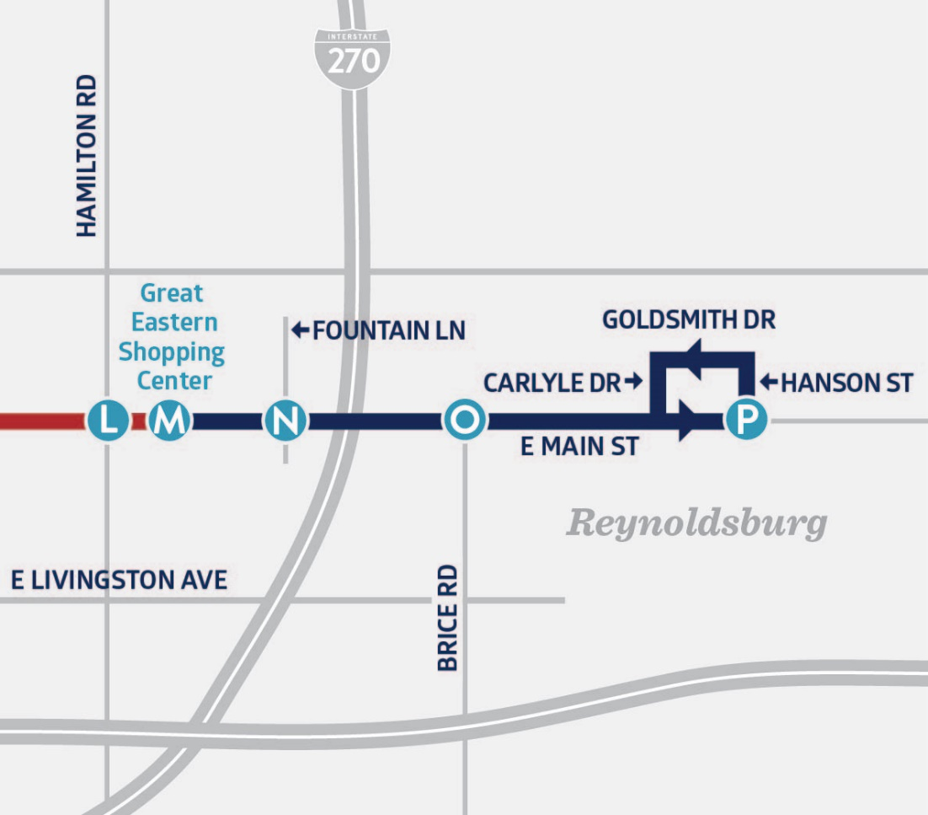
JANUARY 2022 SERVICE CHANGE
Line 2 will return to the Great Eastern Shopping Center layover. Trips from Great Eastern to the end-of-line will run every 30 minutes. Check the destination header on the front of the bus to ensure you board the correct bus.
Line 2 Routing Change
Line 2: Current eastern alignment
Line 2: Eastern alignment in January

Slide 6
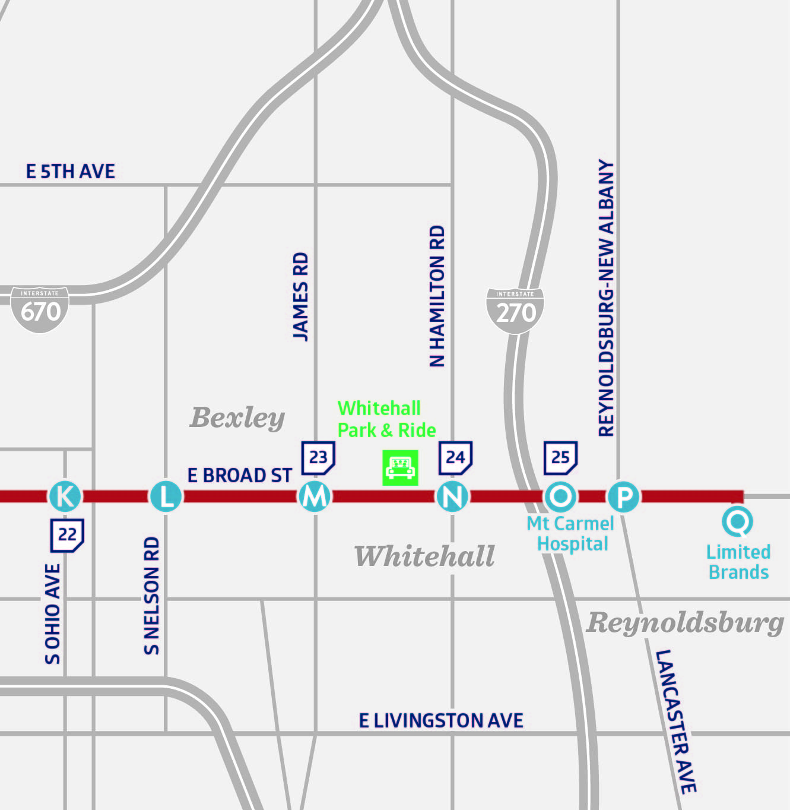
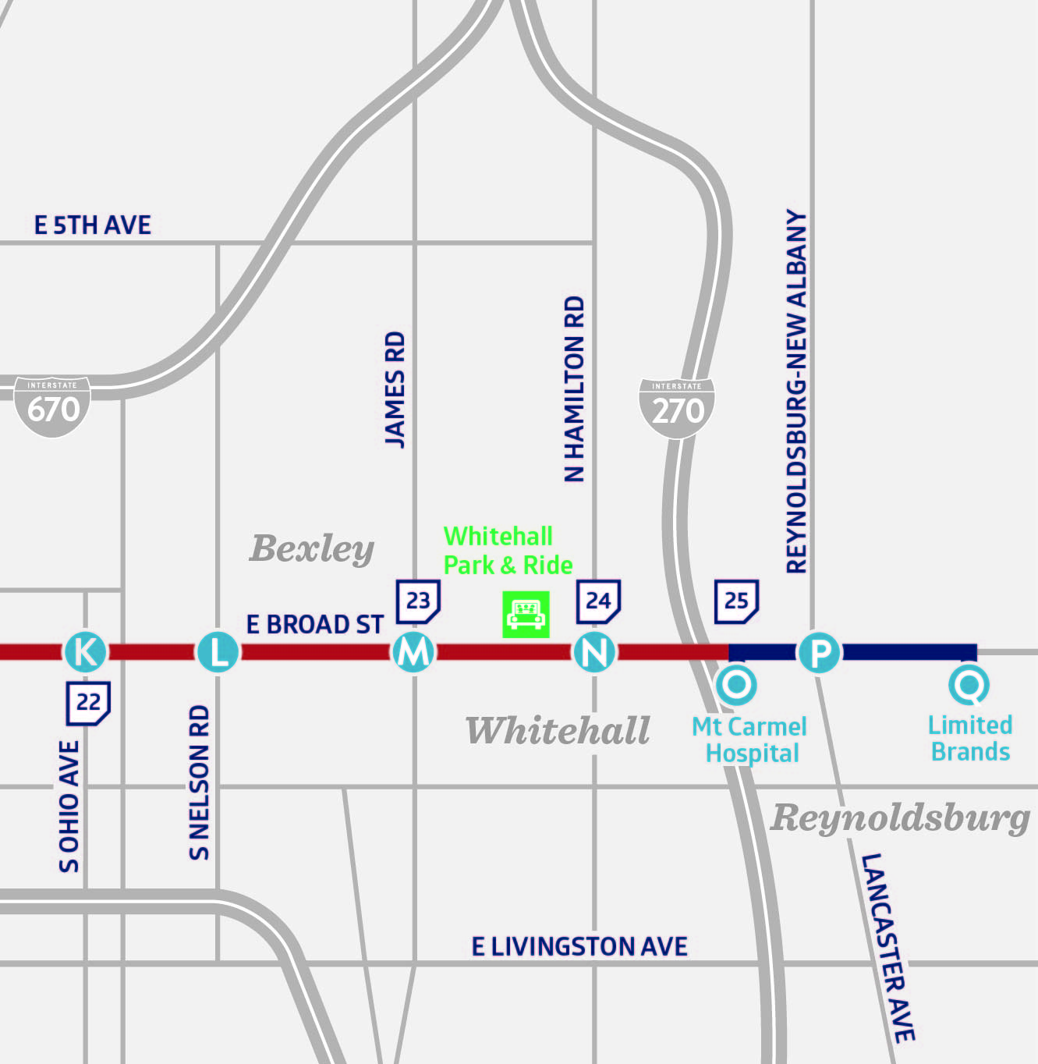
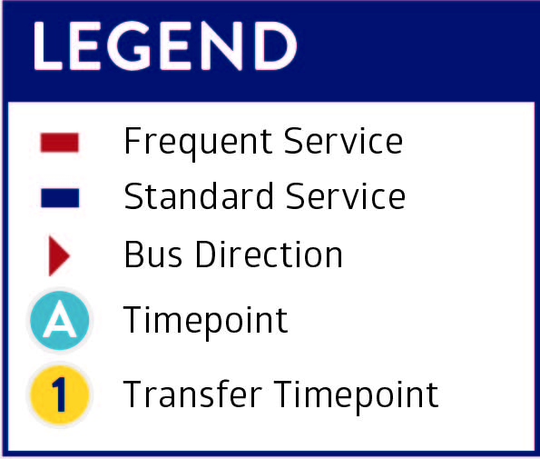
JANUARY 2022 SERVICE CHANGE
Line 10 will return to Mt. Carmel East Hospital. Trips from L Brands to Mt. Carmel East Hospital will run every 30 minutes. Check the destination header on the front of the vehicle to ensure you board the correct bus.
Line 10 Routing Change
Line 10: Current eastern alignment
Line 10: Eastern alignment in January

Slide 7
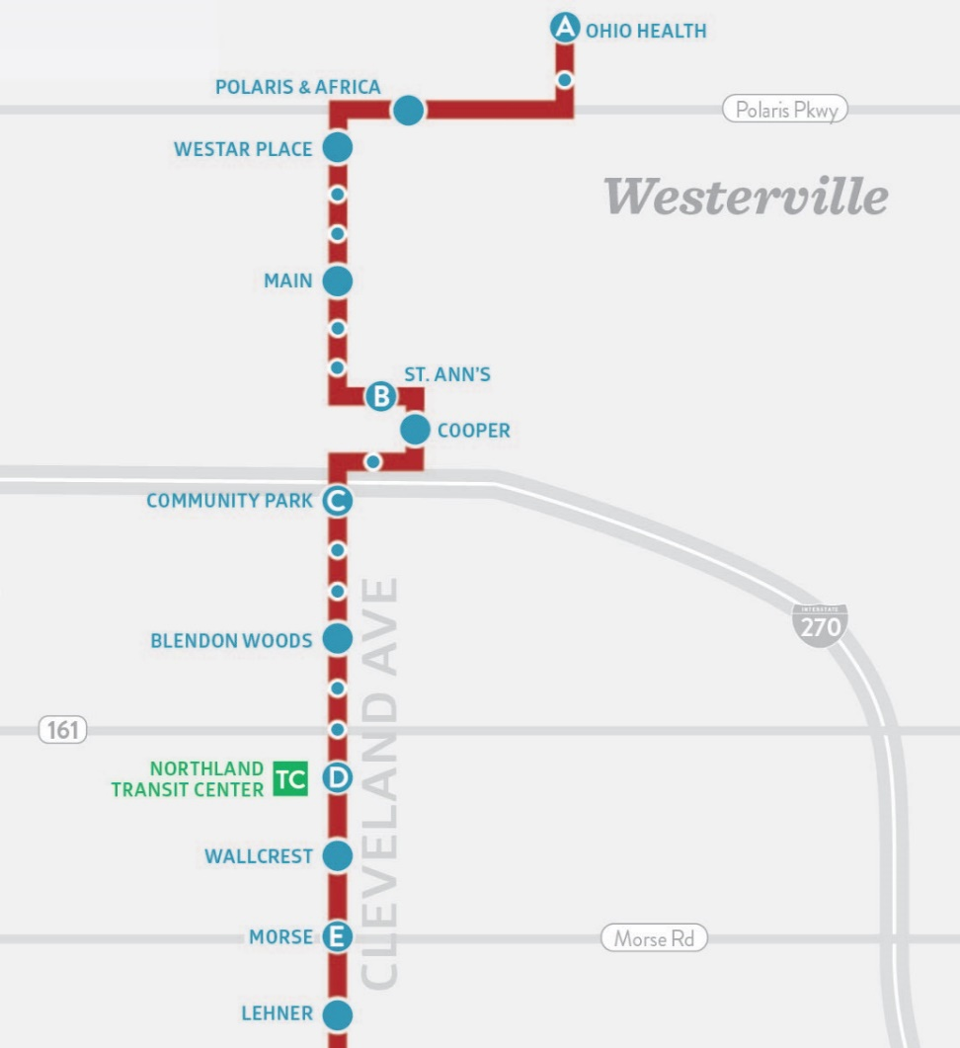
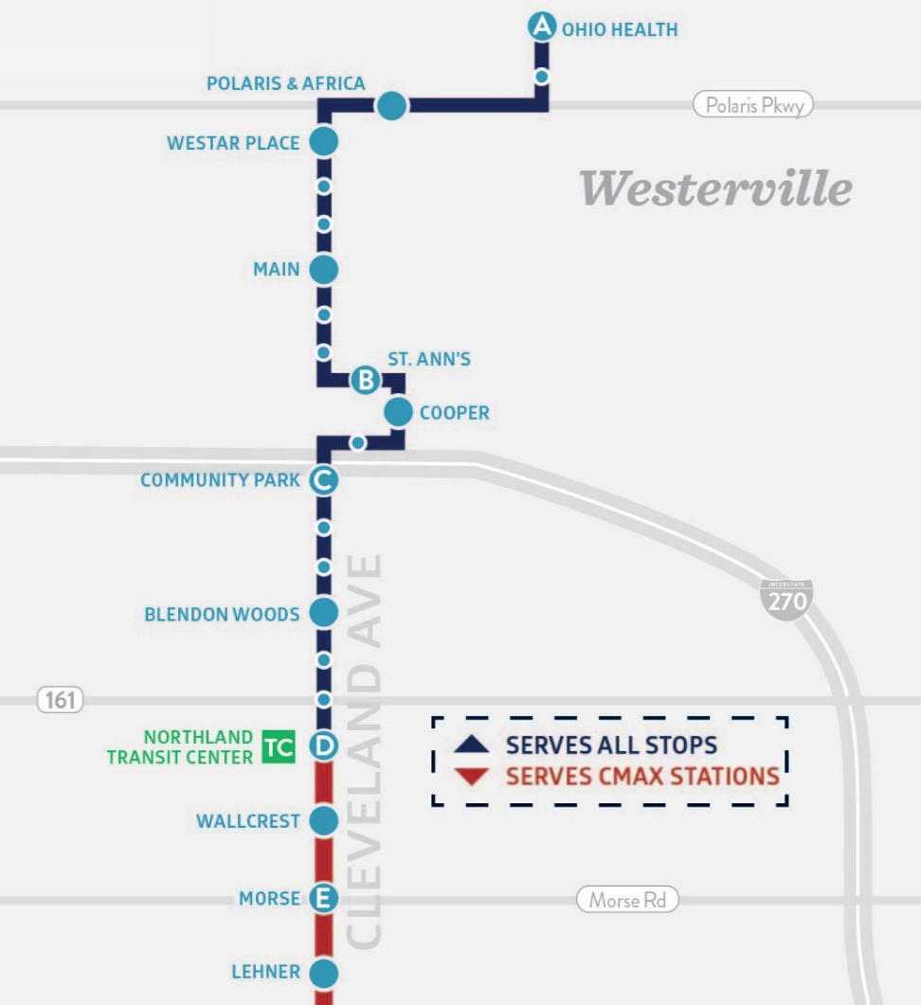
JANUARY 2022 SERVICE CHANGE
CMAX will resume short turning at Northland Transit Center. Trips from Northland Transit Center to Westerville will run every 30 minutes. CMAX travelling to Westerville will use Bays 4 & 5 at Northland Transit Center. CMAX ending at Northland Transit Center will use Bay 1.
CMAX Routing Change
CMAX: Current northern alignment
CMAX: Northern alignment in January

Slide 8
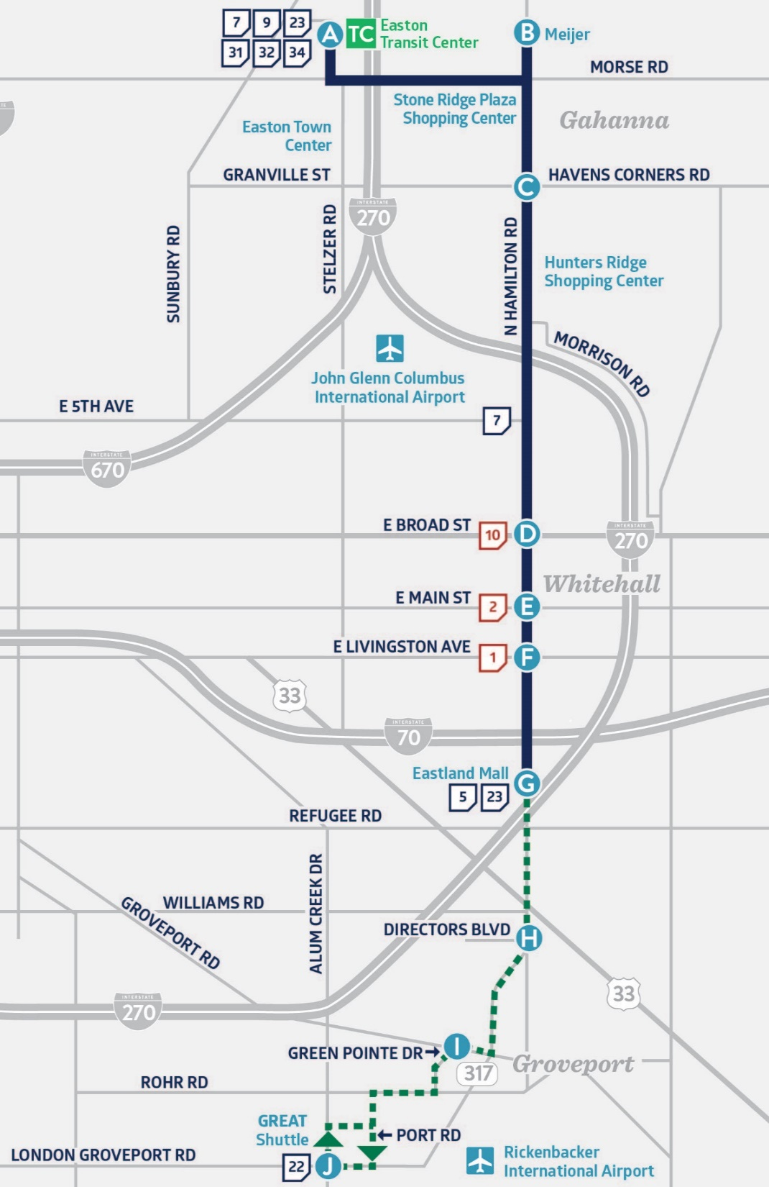

JANUARY 2022 SERVICE CHANGE
Line 24 Route Change
Based on public feedback, service to Rickenbacker will continue. Line 24 will operate hourly between Easton Transit and Eastland Mall.
NEW SERVICE PATTERN
Line 24 will operate as a weekday-only circulator between
Eastland Mall & Rickenbacker from 6am to 9pm. All Line 24 riders
will need to transfer at Eastland Mall to continue riding Line 24.
  To travel north: Board Line 24 vehicles with destination
  "Easton Transit Center."
  To travel south: Board Line 24 vehicles with destination "Rickenbacker."
Destination headers are shown on the front of the bus.

Slide 9
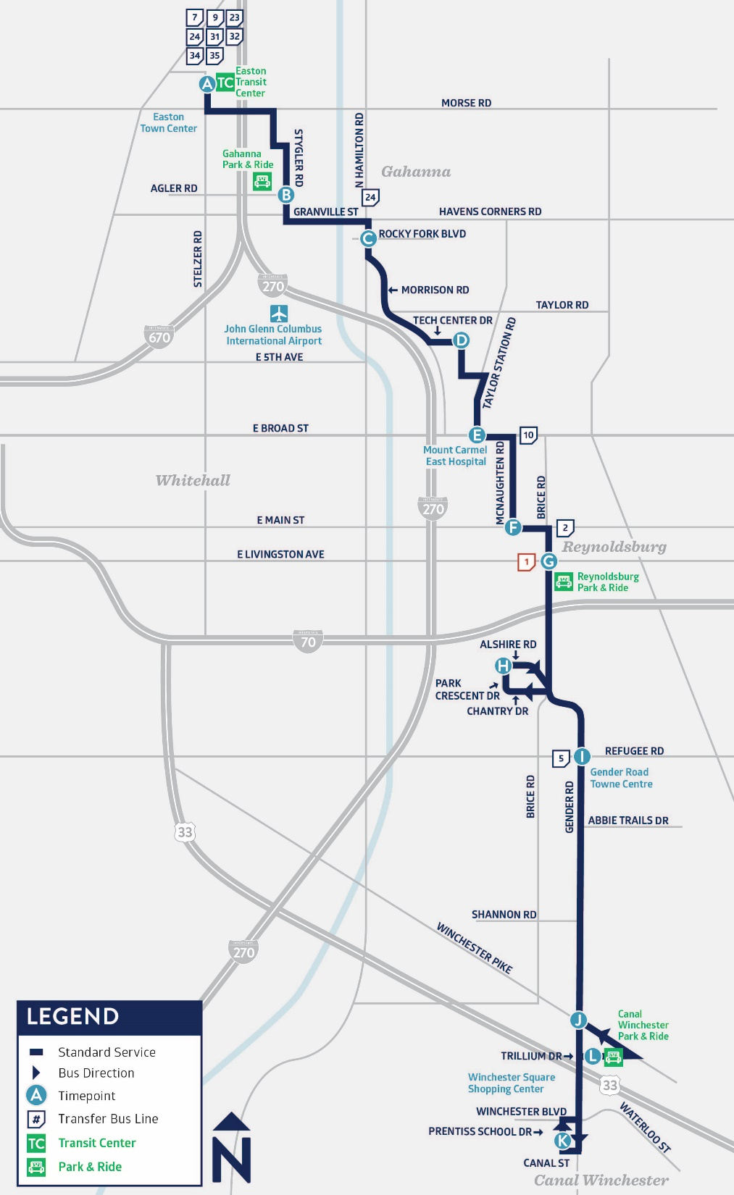
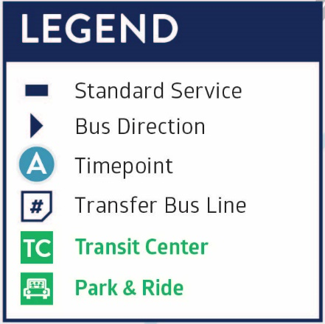
JANUARY 2022 SERVICE CHANGE
Line 25 Service Restoration
Line 25 will return to Easton Transit Center.
Trips from the Canal Winchester Park & Ride to the Easton Transit Center will run every 60 minutes.
Line 25 north of Broad Street will continue to be served by COTA’s Northeast Bus On-Demand zone. Line 25 will no longer layover at Mt. Carmel East Hospital.

Slide 10
Frequency Adjustments
JANUARY 2022 SERVICE CHANGE
LINE NUMBER | LINE NAME | CURRENT FREQUENCY | JANUARY 2022 FREQUENCY
1 | Kenny/Livingston | 10 minutes until 6 p.m. with 15 minutes remainder — seven days a week | 15 minutes core service and 30 minutes Riverside Hospital to Carriage Place — seven days a week
2 | E Main/N High | 10 minutes 10 a.m. to 6 p.m. with 15 minutes remainder — seven days a week | 15 minutes core service and 30 minutes Great Eastern to eastern end of line
3 | Northwest/Harrisburg | 30 minutes — seven days a week | 30 minutes — weekdays 60 minutes — Saturday & Sunday
10 | E Broad/W Broad | 10 minutes on W Broad Street and 15 minutes remainder — seven days a week | 15 minutes core service and 30 minutes Mt. Carmel East Hospital to eastern end of line
22 | OSU/ Rickenbacker | 15 minutes south of Broad Street with 30 minutes remainder — seven days a week | 15 minutes south of Broad Street and 30 minutes remainder — weekdays 30 minutes all day — Saturday & Sunday
23 | James/Stelzer | 30 minutes — seven days a week | 30 minutes — weekdays & Saturday 60 minutes — Sunday
24 | Hamilton | 30 minutes and 60 minute peak service to Rickenbacker — seven days a week | 60 minutes from Easton to Eastland Mall— seven days a week 60 minutes from Eastland Mall to Rickenbacker using service extension –weekdays only
34 | Morse | 30 minutes — seven days a week | 30 minutes — weekdays 60 minutes — Saturday & Sunday
102 | N High/Polaris Pkwy | 30 minutes — seven days a week | 60 minutes — seven days a week
CMAX |  | 10 minutes from 3 p.m. to 6 p.m. with 15 minutes remainder | 15 minutes core service and 30 minutes Northland Transit Center to Westerville

Slide 11
New Policy Updates

Slide 12
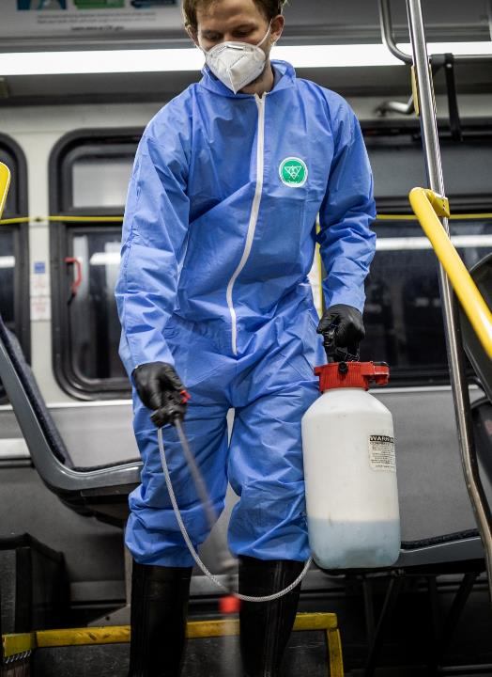
COVID-19 Policy Updates
How is COTA keeping customers and employees safe?
COTA will continue to follow federal laws which still require masks to be worn on all transit vehicles.
COTA will also continue to provide the following
measures to keep customers and employees safe:
Cleaning and sanitization on all transit vehicles and
at high-ridership stops
Installed operator barriers on fixed-route fleet
Proper ventilation
Hand sanitizer

Slide 13
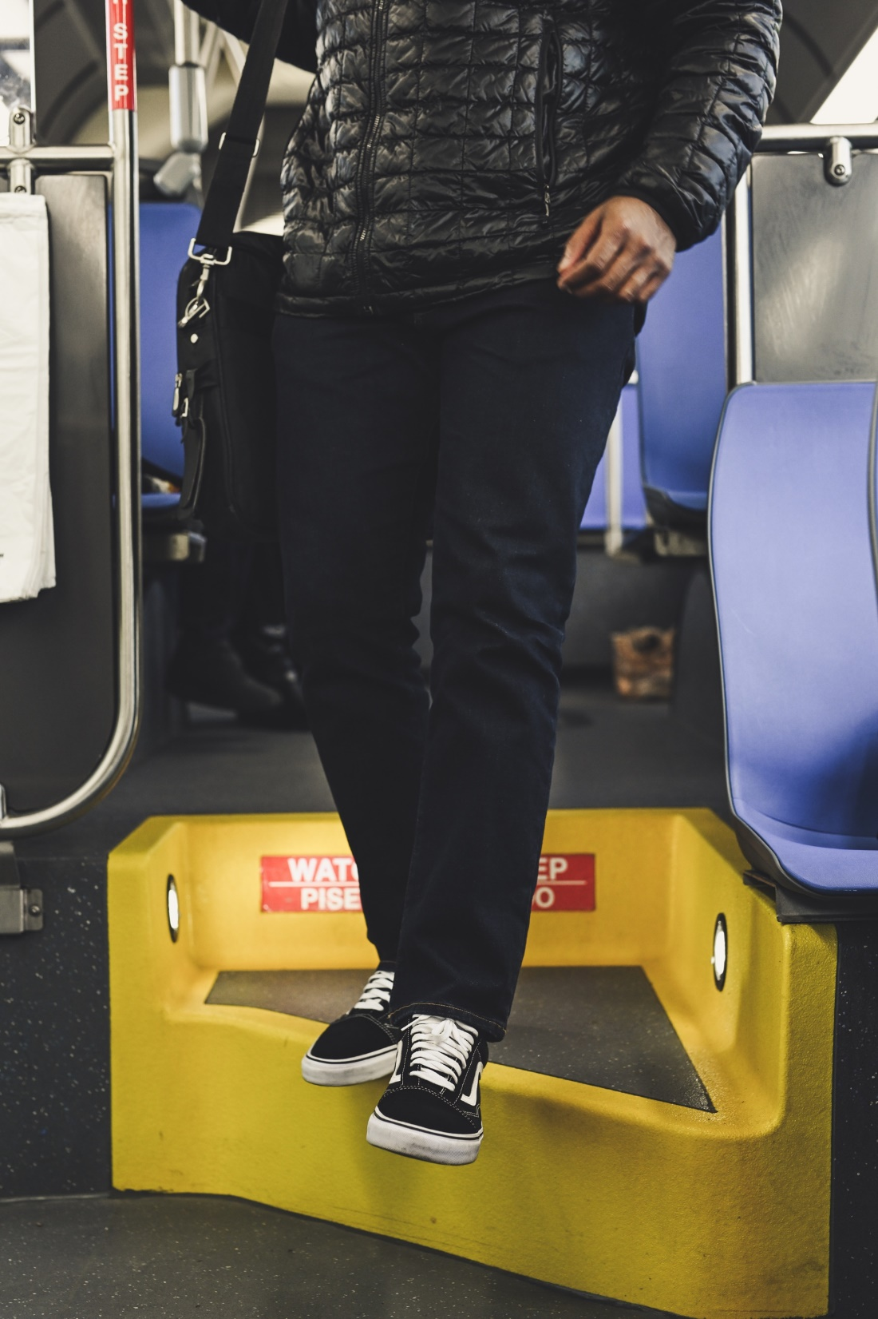
End of the Line Policy
NEW POLICY EFFECTIVE DEC. 6, 2021
The new policy will require all customers to disembark at the end of the line and can board five (5) minutes prior to departure.
This policy change was made to allow for our operators to take their necessary layover time, prepare for their next trip, and ensure their vehicle is safe, secure, and ready for the next trip on the line of service.
Operators will notify customers prior to final stop of opportunities to disembark with shelters.
Notes:
When it’s time to board, customers will be allowed on the vehicle five minutes before the scheduled departure time.
Customers who plan to reboard or take another line following deboarding will be required to show their fare media to board again. This includes digital fare or a transfer ticket.
A transfer ticket will not be issued at the end of the line.
If a customer refuses to disembark, TSS (transit supervisor) will be notified and come to support the operator.

Slide 15
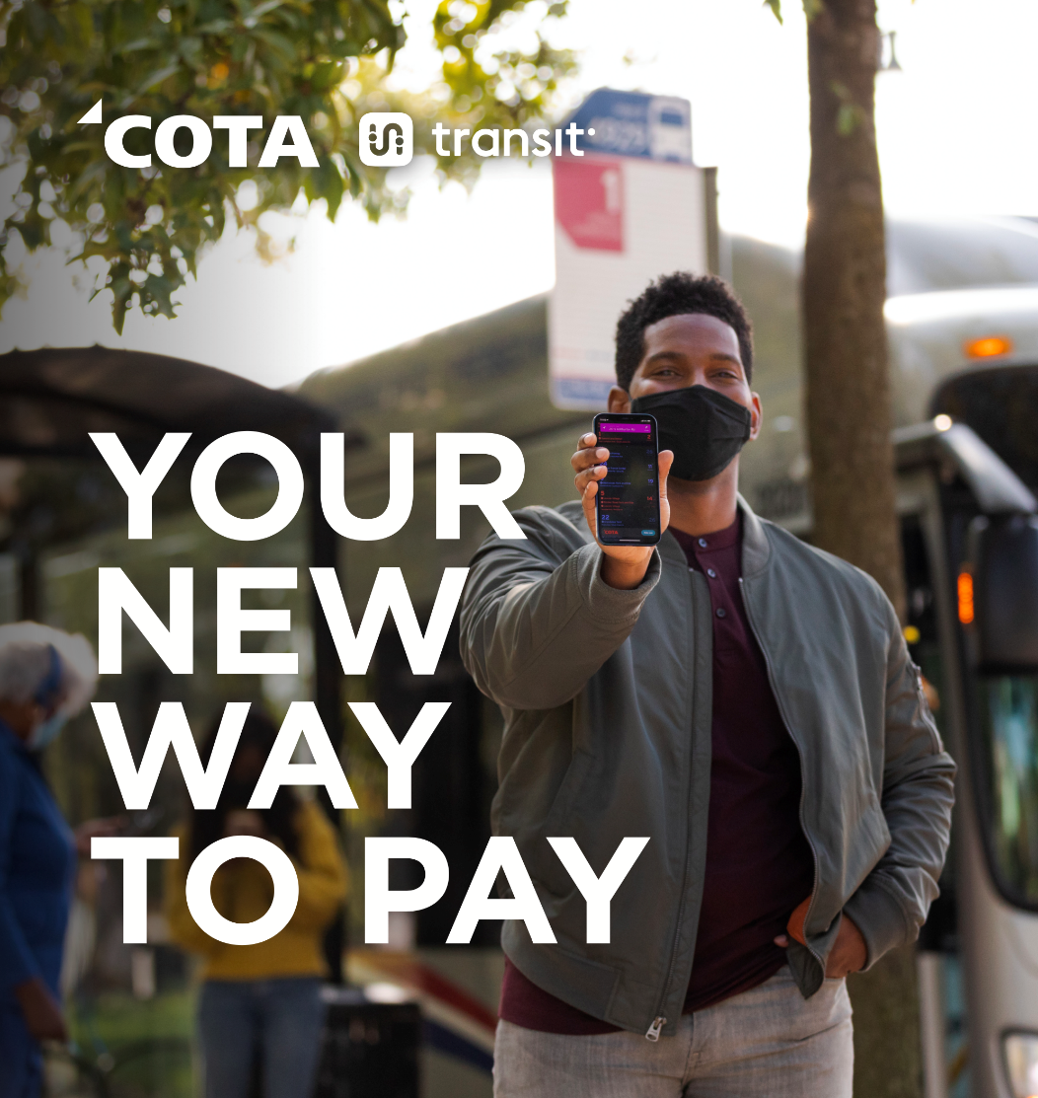
New Fare Payment System
On Nov. 1, 2021, COTA introduced an exciting new fare payment system. The benefits of this new system include:
Fare capping ($4.50/day and $62/month)
2-hour fares (simplified transfers)
Smartphone and Smartcard payment options
Learn more at COTA.com/transitapp.

Slide 16
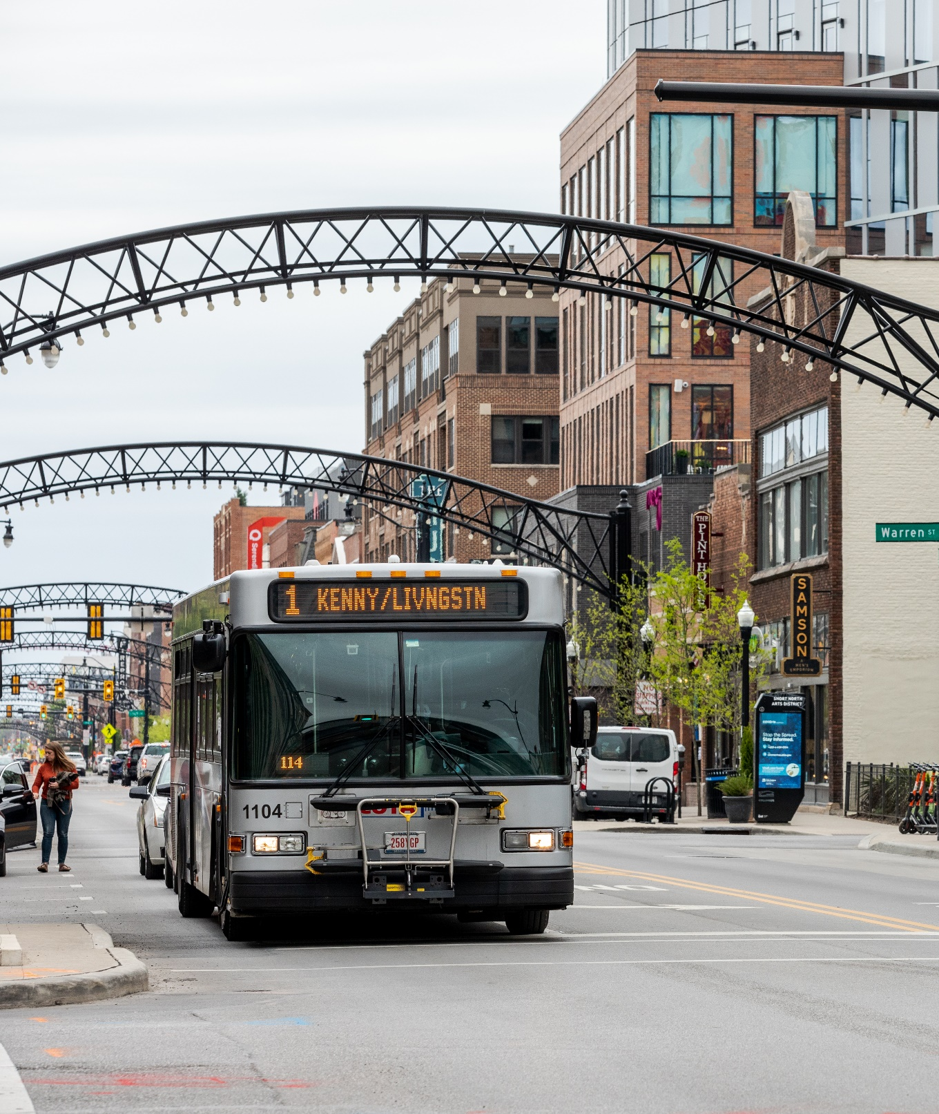
Workforce
Challenges
COTA will continue to adjust its transit schedules due to unprecedented workforce challenges caused by the ongoing COVID-19 pandemic.
The adjustments will be made to improve service reliability and help minimize adverse service impacts to our customers and staff.
COTA continues to recruit, hire and train new operators, while dealing with higher-than-usual attrition.

Slide 17
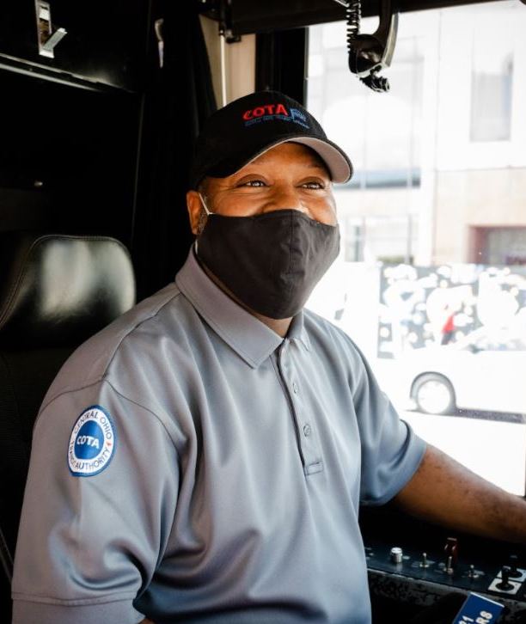
COTA is Hiring Operators
COTA is actively recruiting, hiring and training new operators. Anyone interested in a rewarding career at COTA can learn more and apply at COTA.com/careers.
SERVICE REQUESTS
COTA will continue to document requests for
service and work to restore service hours.

